Slide 1

Rockbuster Insights
Tableau Link: https://public.tableau.com/shared/9CFFC7HMJ?:display_count=n&:origin=viz_share_link

Slide 2

Key Questions
Where are we most profitable?
What affects film rental profitability the most?
Best customers and where to find them.

Slide 3
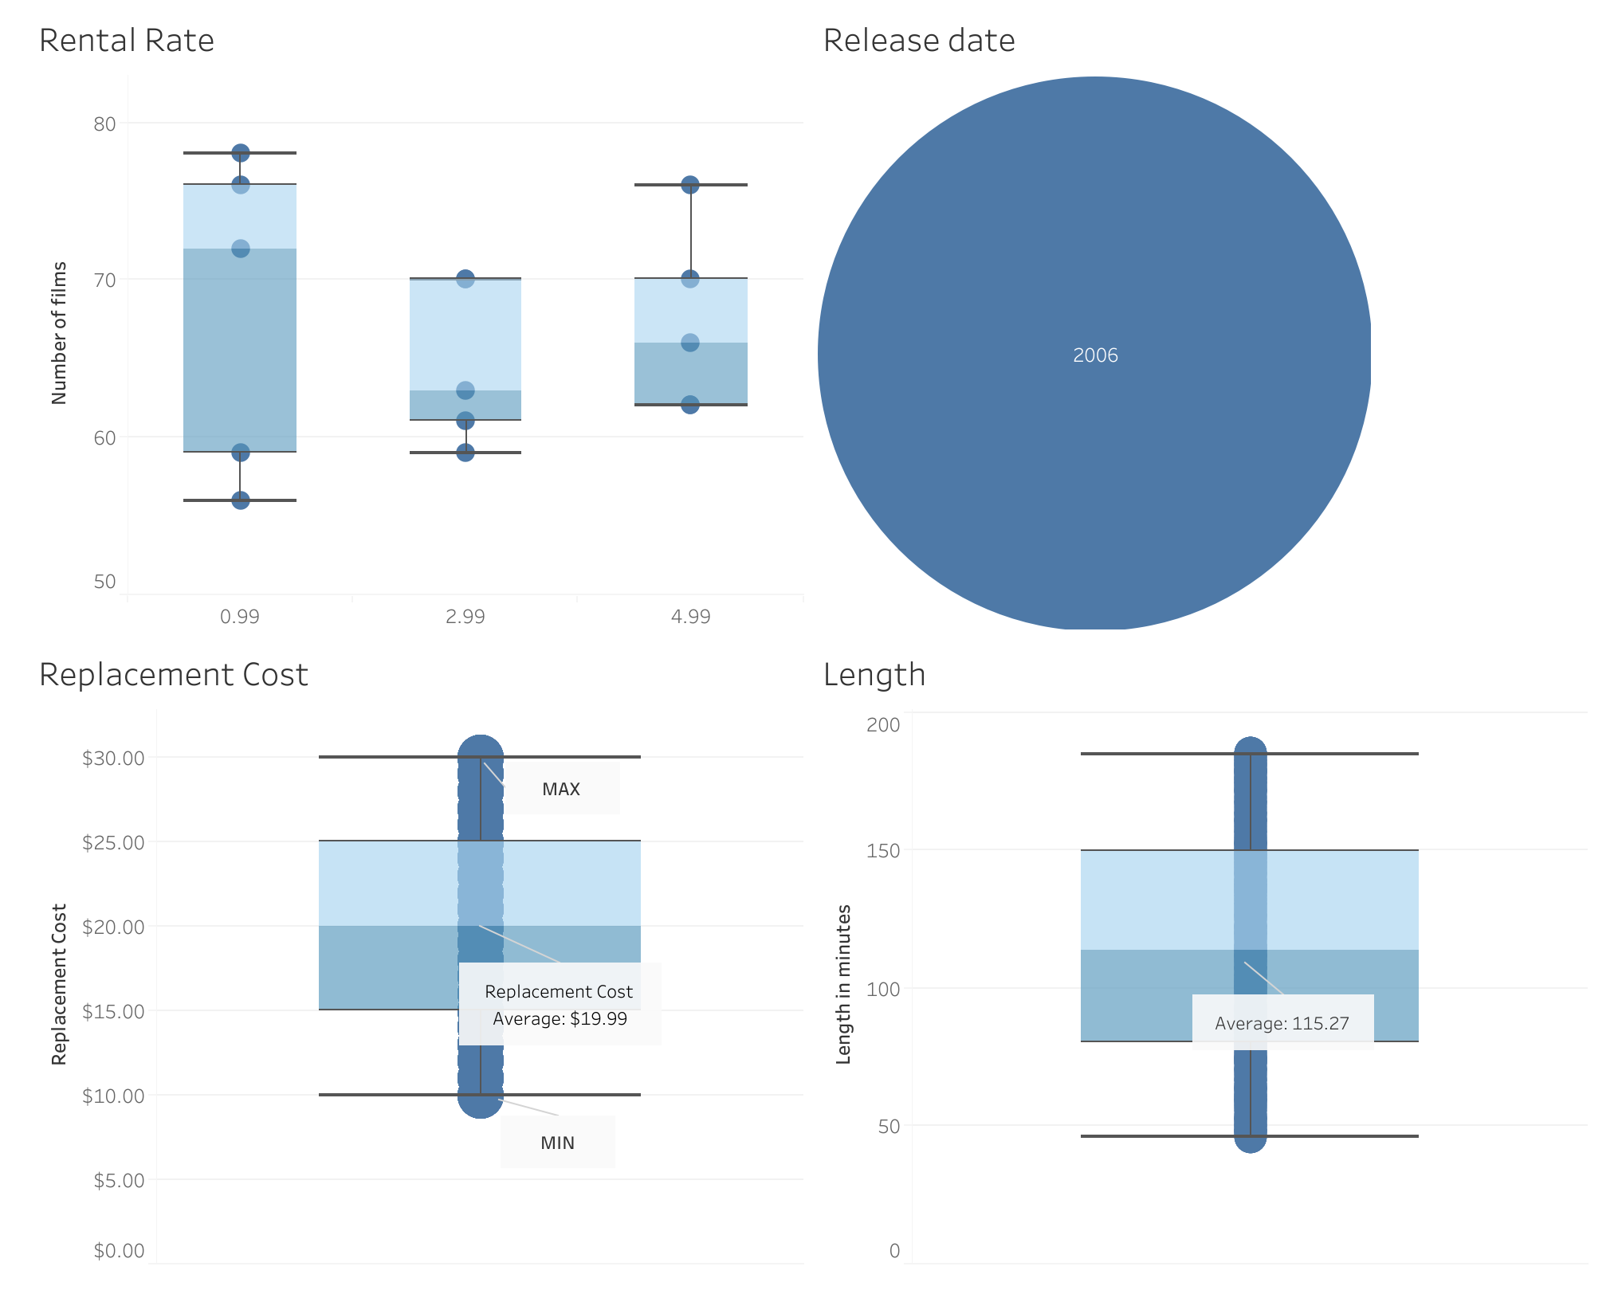
A glimse into the data
Three categories of rental rate
All film were released in 2006
Varying length of films
Varying length of replacement costs in case we lose a film

Slide 4
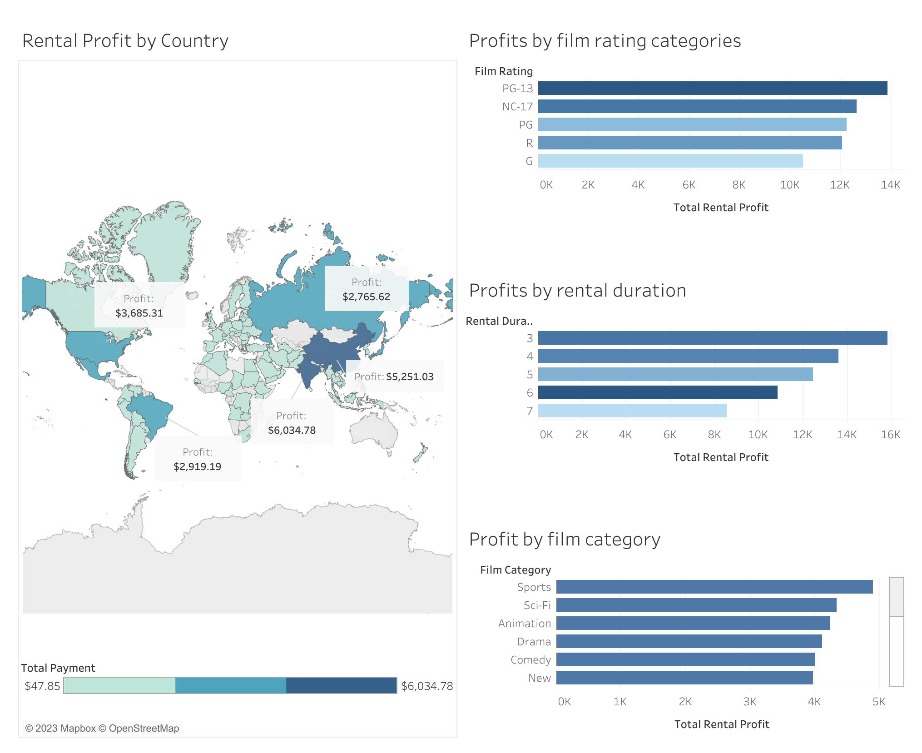
Profitability
Top 5 Countries:
India
China
USA
Brazil
Russia
Most profitable rating: PG-13
Most profitable rental duration category: 3 days
(* although most films have a 6-day rental duration period)
Most profitable film category: Sports
(* marginal differences amongst categories)

Slide 5
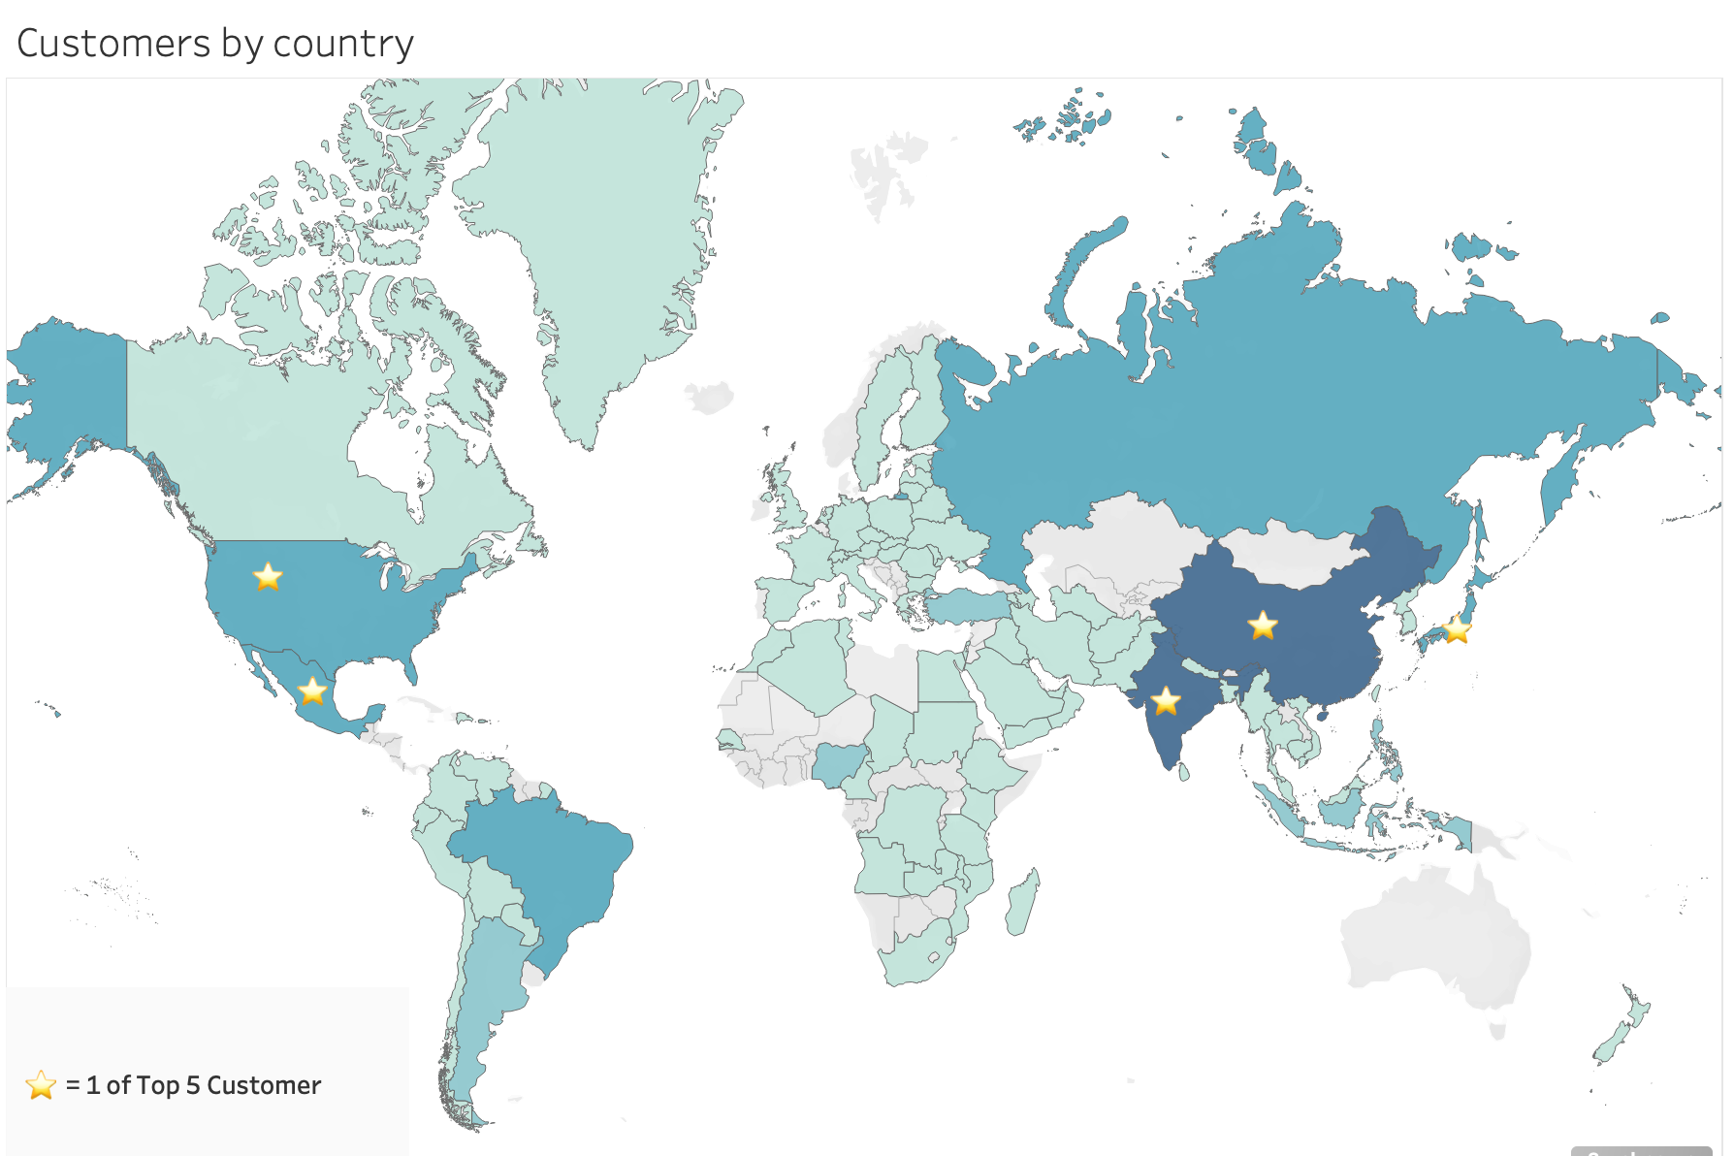
Marketing Question – Best Customers and Where to Find Them

Slide 6
Conclusions & Recommendations
Upgrade our inventory to include more recent movies with a dual focus on PG-13 and NC-17 rated films.
Top 3 countries to increase marketing efforts: India, China, USA.
Experiement with expanding the 3-day rental duration period to more films.

Slide 7

Any Questions?

